Slide 1
GLUCOSENSE : AI-POWERED DIABETES DETECTION FOR EARLY INTERVENTION
BY :
MAHESH KUMAR S

Slide 2
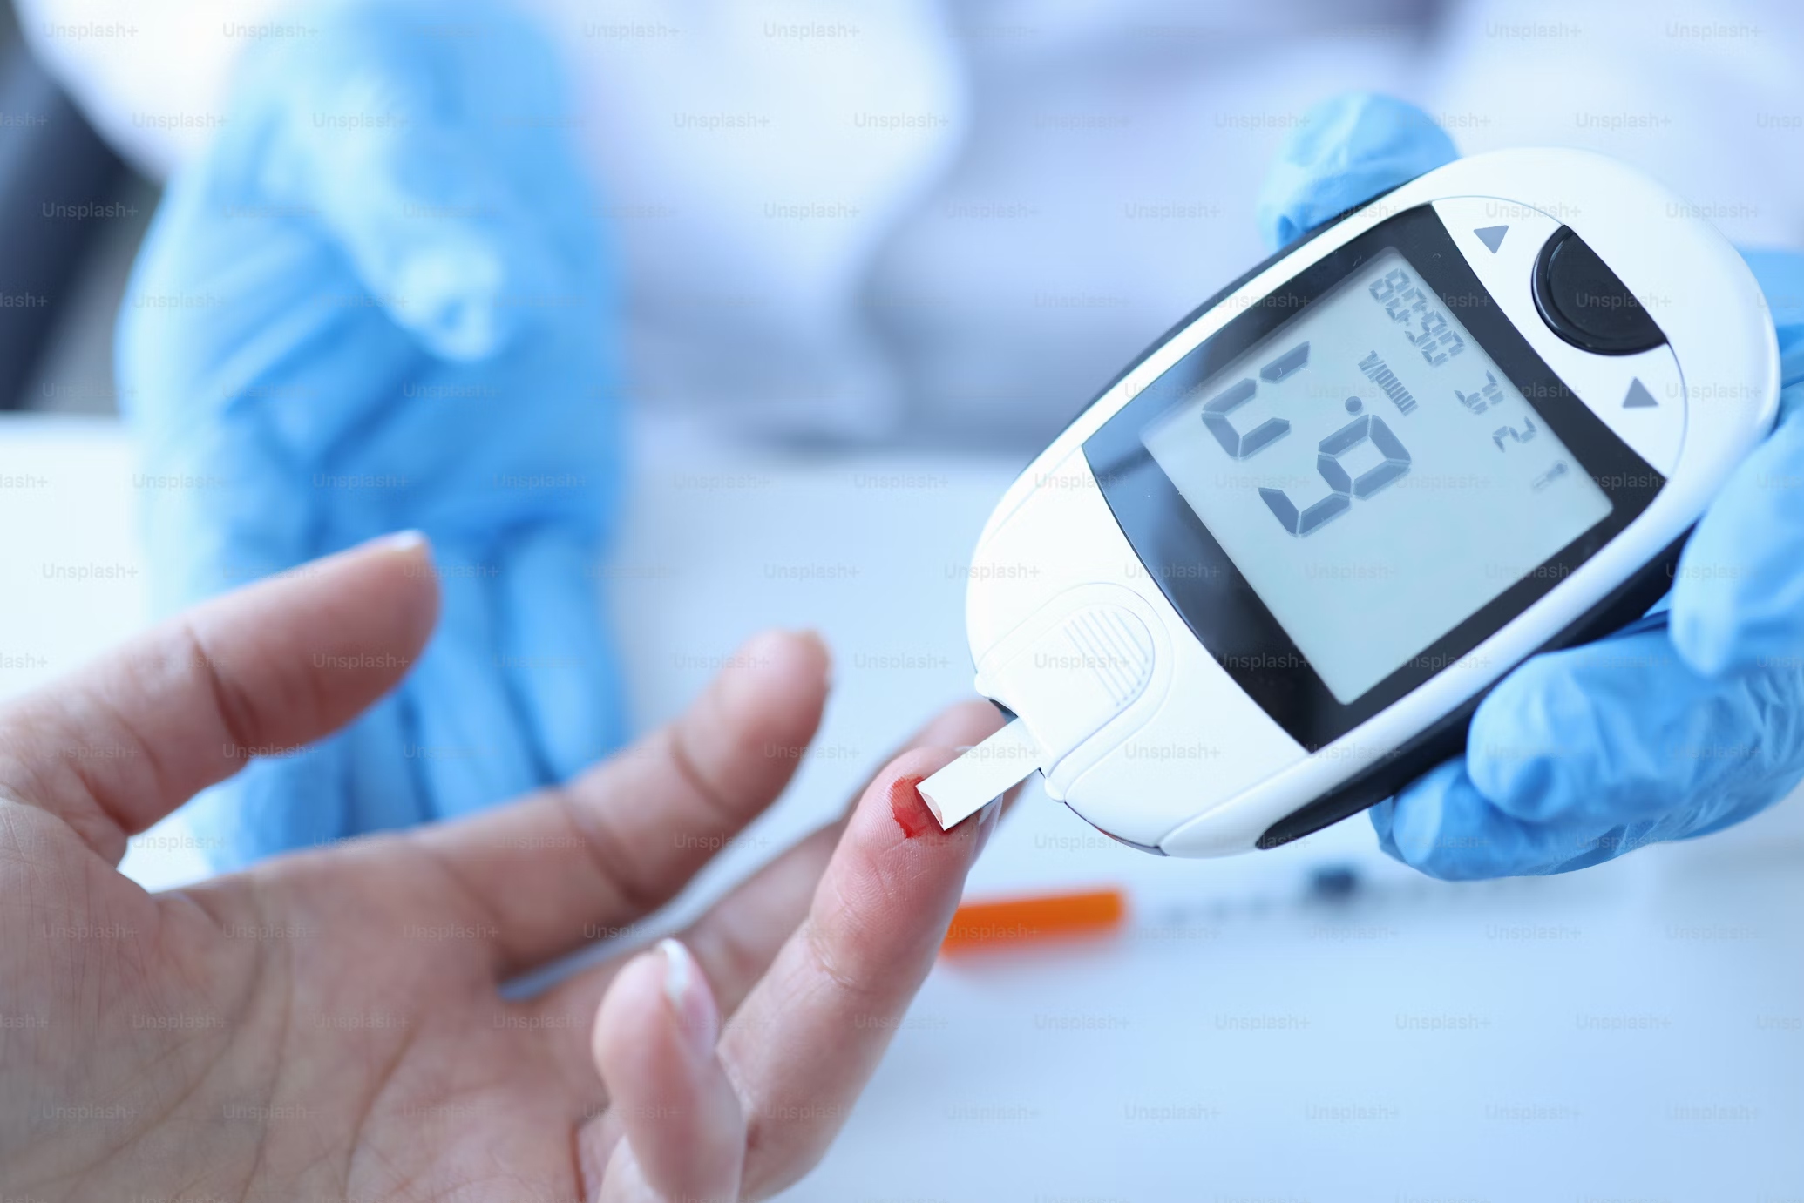
INTRODUCTION
Diabetes is a widespread chronic condition that requires early detection and intervention to prevent severe health complications.
GlucoSense is an AI-powered solution designed to predict diabetes risk by analyzing key health and lifestyle indicators.
By leveraging machine learning algorithms, GlucoSense offers accurate and efficient predictions, enabling healthcare providers to identify at-risk individuals and promote early preventive measures.
This approach enhances diabetes management and contributes to better health outcomes for patients.

Slide 3

PROBLEM STATEMENT
Diabetes is a growing health concern worldwide, with increasing cases influenced by lifestyle factors and a lack of early detection.
Many people remain undiagnosed, leading to severe complications that could be mitigated through timely intervention.
This project aims to predict diabetes risk by analyzing key health indicators using AI-powered machine learning models, facilitating early diagnosis and prevention.

Slide 4
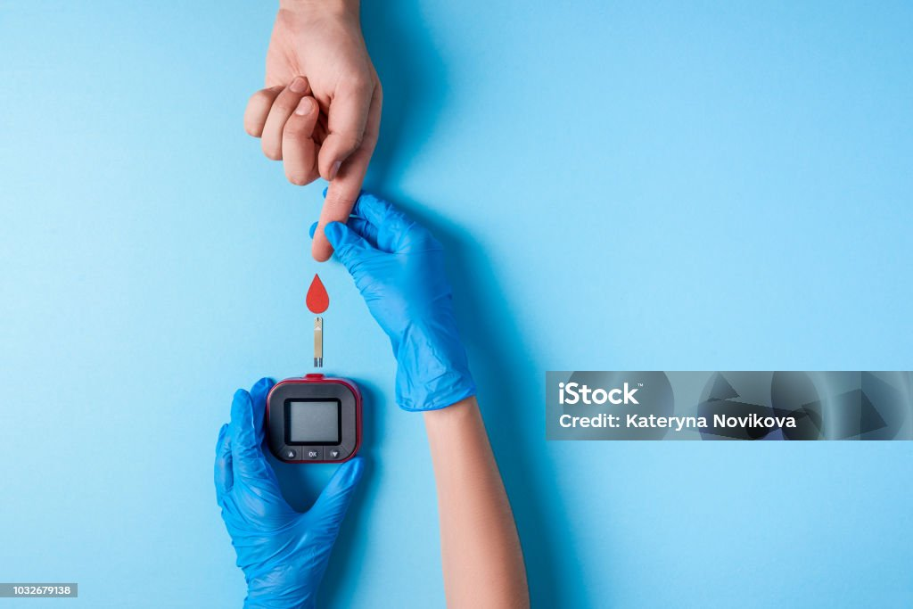
SOLUTION
GlucoSense leverages advanced AI and machine learning techniques to provide an efficient and reliable solution for early diabetes detection.
By analyzing critical features such as glucose levels, BMI, and symptoms like polyuria and polydipsia, it predicts diabetes risk with high accuracy.
The system incorporates feature selection, data preprocessing, and ensemble learning models like Random Forest and Extra Trees to enhance prediction performance.
This scalable and robust solution ultimately improving patient outcomes and reducing diabetes-related complications.

Slide 5
IMPORTANCE OF EARLY DIABETES DETECTION
Timely Intervention: Early detection allows individuals to begin treatment and lifestyle modifications at the right time, significantly reducing the risk of long-term complications.
Health Awareness: Increased awareness and testing empower individuals to understand their health better and take preventive measures to avoid the onset of diabetes.
Risk Reduction: By predicting diabetes early, individuals have the opportunity to reduce risk factors through personalized interventions, such as dietary adjustments, exercise, and medication.
Improved Outcomes: Early diagnosis leads to better health outcomes by delaying or preventing complications like cardiovascular diseases, kidney damage, and neuropathy.

Slide 6
DATA COLLECTION
Dataset Source: The dataset is likely sourced from platforms like Kaggle or similar repositories that provide structured healthcare data for analysis.
Features Included: The dataset includes attributes such as glucose levels, BMI, age, polyuria, polydipsia, and other indicators like sudden weight loss, weakness, and irritability, which are essential for predicting diabetes risk.
Preprocessing Insights: The dataset has undergone preprocessing steps such as duplicate removal, outlier detection (IQR method), and feature selection to ensure data quality and relevance for modeling.

Slide 7
DATA EXPLORATION & DATA PREPROCESSING
Dataset Overview: Analyzed dataset structure with 520 rows and 17 columns.Ensured no missing values in the dataset.
Duplicate Removal: Identified and removed 269 duplicate rows for unbiased analysis.
Correlation Analysis: Used a correlation matrix to explore relationships among variables.
Outlier Detection: Detected and removed outliers using the Interquartile Range (IQR) method.
Data Cleaning: Cleaned the dataset by removing inconsistencies and irrelevant data for better model performance.

Slide 8
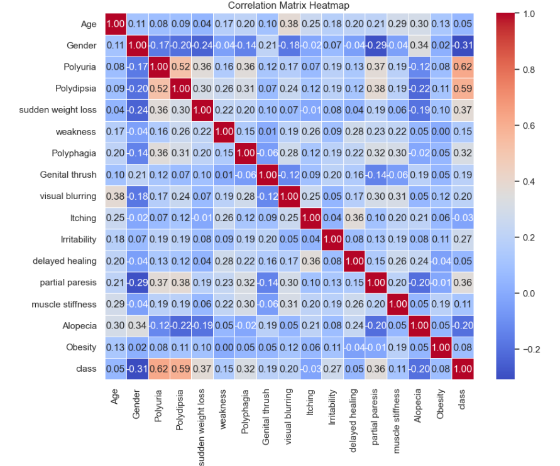
CORELATION MATRIX

Slide 9
FEATURE SELECTION
Identifying relevant features that contribute to the accurate prediction of diabetes in the glucoSense system.
Using statistical techniques like correlation analysis and mutual information to evaluate the strength of relationships between variables and the target outcome (diabetes detection).
Reducing dimensionality by eliminating redundant or irrelevant features, ensuring the model remains efficient and interpretable.
Applying techniques such as Recursive Feature Elimination (RFE) or Lasso regression to iteratively select the most important features.
Enhancing model performance by focusing on key indicators like blood sugar levels, age, BMI, and other vital health parameters relevant to diabetes risk prediction.

Slide 10
MODEL EVALUATION
Accuracy: Measures the overall proportion of correct predictions, indicating the model's general performance.
Precision and Recall: Precision shows how many predicted positives are correct, while recall measures how many actual positives are correctly identified. Both are important for understanding the model's effectiveness in detecting diabetes.
ROC-AUC: Evaluates the model’s ability to distinguish between the classes, providing an overall measure of performance across different thresholds.

Slide 11
RESULTS
The results of glucoSense: AI-powered diabetes detection show that the model effectively predicts diabetes risk based on key health indicators such as blood sugar levels, age, and BMI.
With high accuracy, precision, and recall, it successfully identifies individuals at risk, aiding in early detection.
The model’s performance is further validated through the ROC-AUC score, indicating strong discriminatory power between diabetic and non-diabetic individuals.
These results demonstrate the model’s potential to improve early intervention and prevent the onset of diabetes through timely predictions.

Slide 12
CONCLUSION
Evaluating the model for glucoSense: AI-powered diabetes detection involves a comprehensive assessment using key metrics like accuracy, precision, recall, and ROC-AUC. These metrics provide a clear understanding of the model's performance in detecting diabetes, balancing false positives and false negatives, and ensuring reliable early intervention. By focusing on these evaluation criteria, the model can be fine-tuned to maximize its effectiveness in predicting diabetes, ultimately aiding in timely diagnosis and better healthcare outcomes.

Slide 13
FUTURE ENHANCEMENT
Future enhancements for glucoSense could include integrating real-time data from wearable devices to improve prediction accuracy. Expanding the model with additional health data, such as genetic and lifestyle factors, would provide a more personalized approach. Implementing AI explainability techniques would ensure transparency in predictions. Additionally, incorporating real-time alerts and continuous learning could make the system more adaptive and responsive to individual health changes.

Slide 14
THANK YOU

